Slide 1



AI in Education: For School Districts, Teachers, and Students
Unlocking the Potential of ChatGPT in Learning Environments
by M. Abdullah Canbaz, Ph.D.
Department of Information Sciences and Technology
College of Emergency Preparedness, Homeland Security, and Cybersecurity
University at Albany, SUNY

Slide 2



Introduction to AI in Education
Modern Education
Potential Benefits
AI in Education
Personalizing learning experiences, enhancing engagement, and streamlining administrative tasks for a more efficient and inclusive educational environment
Instant feedback, learning gap identification, engagement through interactive tools, streamlined teacher tasks, and enhanced administrative efficiency.
Revolutionize traditional teaching and learning processes by supporting differentiated learning, Prepare teachers and students for a technology-integrated future

Slide 3
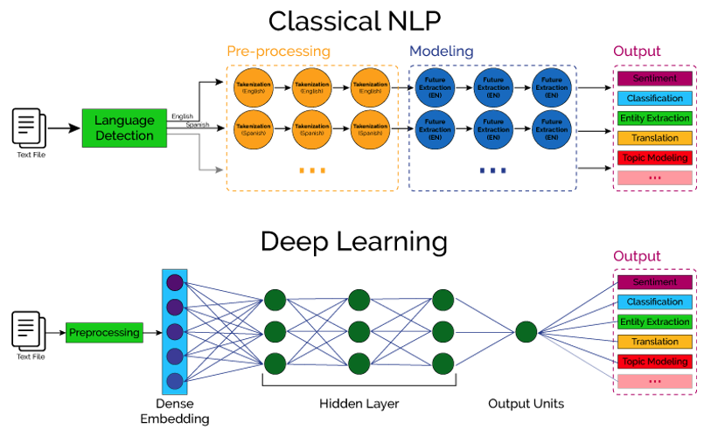
Introduction to Large Language Model (LLM)s
ChatGPT [ Tip of the Iceberg]
It’s all about
Probabilities
Likelihoods
Correlation
Weights
Thresholds

Slide 4
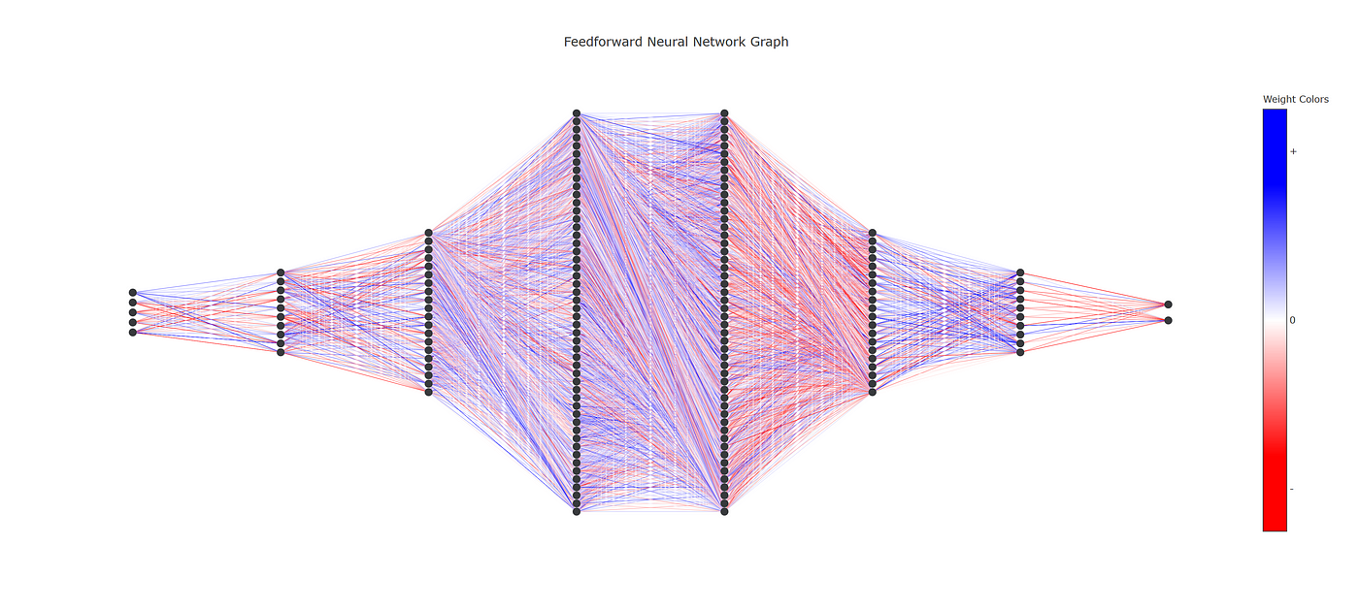
Introduction to Large Language Model (LLM)s
ChatGPT [ Tip of the Iceberg]
GPT-3 : 3,125 Words
GPT-4 : 25,000 Words

Slide 5

Introduction to Large Language Model (LLM)s
ChatGPT [ Tip of the Iceberg]

Slide 6
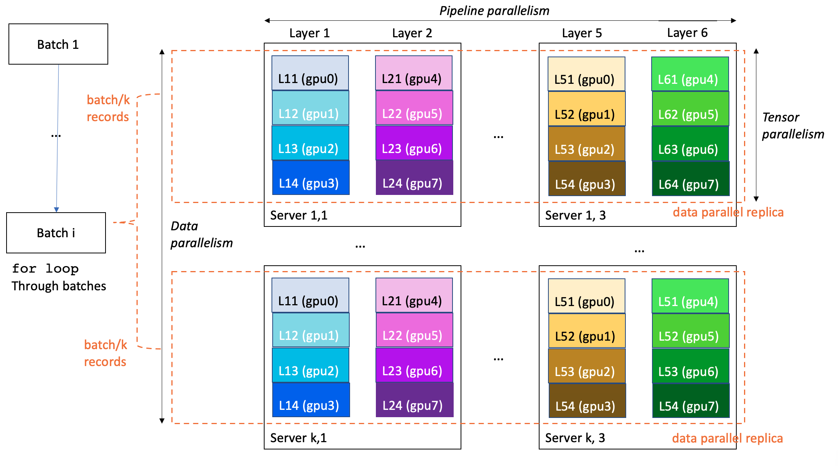
Introduction to Large Language Model (LLM)s
ChatGPT [ Tip of the Iceberg]

Slide 7

ChatGPT in the Classroom
Its capabilities include facilitating discussions, answering questions, and generating educational content.
Personalized Learning: Can be tailored to educational content to meet individual student needs, preferences, and learning speeds, enhancing the personalization of learning experiences.
Homework and Assignment Assistance: an on-demand tutor
Language Learning: offering practice in reading, writing, and conversational skills across multiple languages.
Feedback and Grading: providing feedback on student assignments
Engagement: keep students engaged in learning topics by answering questions, providing explanations, and encouraging exploration of subjects in depth.
Accessibility: an accessible form of learning for students with disabilities or those who need additional support, ensuring educational content is available to a broader audience.
Curriculum Development: develop lesson plans, create educational content, and generate creative teaching materials tailored to their curriculum goals.

Slide 8
For School Districts
Centralized Resource Management: Using ChatGPT for efficient distribution and accessibility of educational resources.
Professional Development: Training educators to integrate AI into their teaching methodologies.

Slide 9

For Teachers
Creative Lesson Planning: ChatGPT can assist in developing innovative and engaging curriculum plans. By leveraging AI, educators can access a multitude of creative ideas and approaches to curriculum development.
Classroom Interaction: Utilizing AI for student engagement, AI-assisted discussions, and personalized feedback can enhance the overall learning experience, fostering an interactive classroom environment.
Example Prompt: “Generate a lesson plan on renewable energy sources for a 9th-grade science class.”

Slide 10

For Students
ChatGPT offers personalized learning, meeting individual learning styles and needs.
It acts as a homework helper, supporting students with assignments and projects.
Example Prompt:
"Explain Newton's Third Law of Motion in simple terms."

Slide 11

AI for Assessment and Evaluation
Objective Grading: AI provides an unbiased assessment of
student work.
Feedback Mechanism: Constructive feedback for continuous
learning improvement.

Slide 12
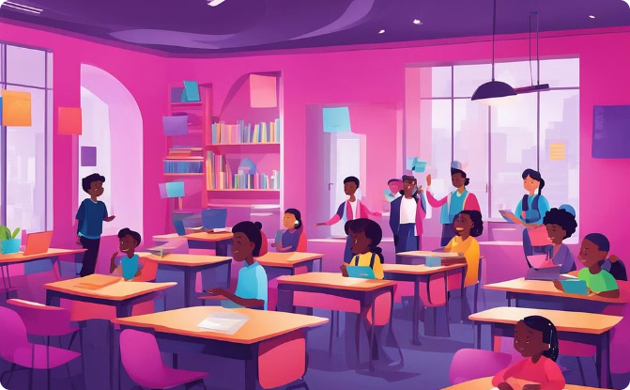

AI for Equity in Classrooms
Removing Bias
Accessibility
AI integration ensures equal treatment for all students, fostering a fair and inclusive environment.
AI can be used to provide personalized support for students with special needs and language barriers, promoting inclusivity.

Slide 13

Partnership Opportunities
Training [and Certificate] Programs
We can offer introductory courses on AI, prompt engineering, and assessment and evaluation techniques.
EagleGPT Development
A specifically tailored AI model for BCSC is possible
Depending on funding, hardware, and expertise.
Faculty/PhD Student Involvement
Engage academic experts to develop custom AI solutions for educational settings.

Slide 14
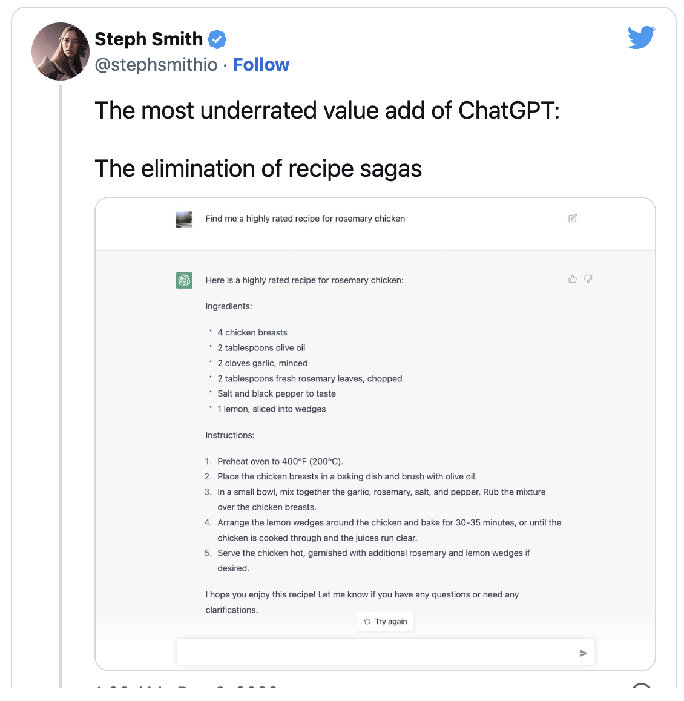
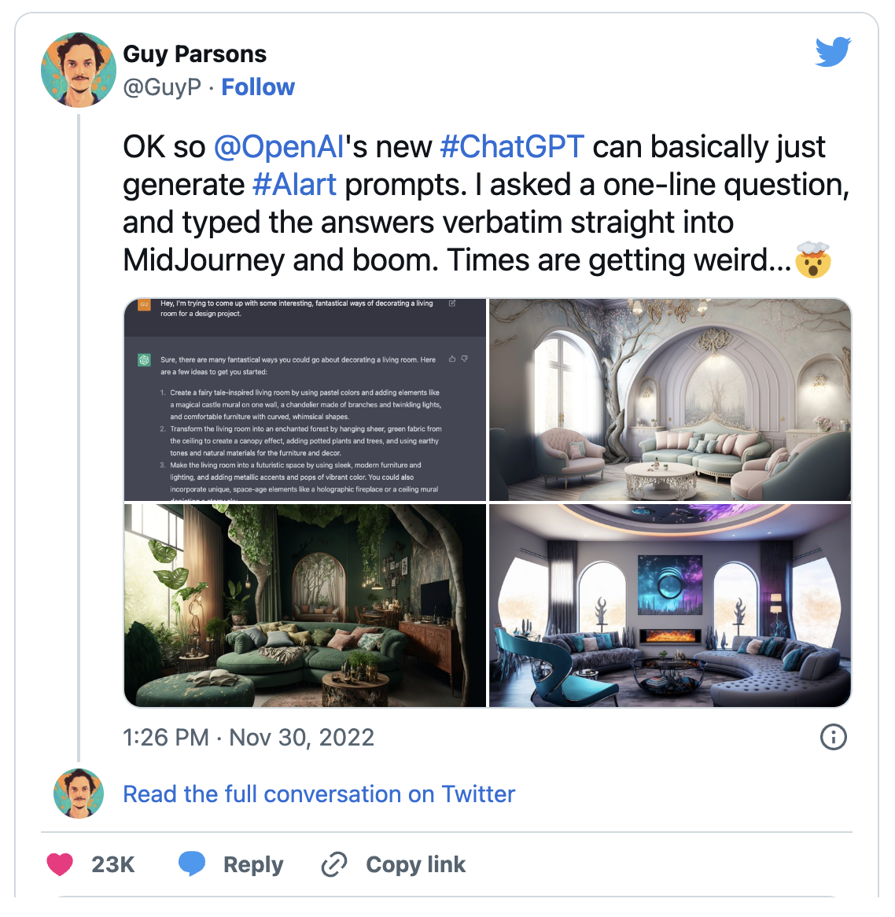
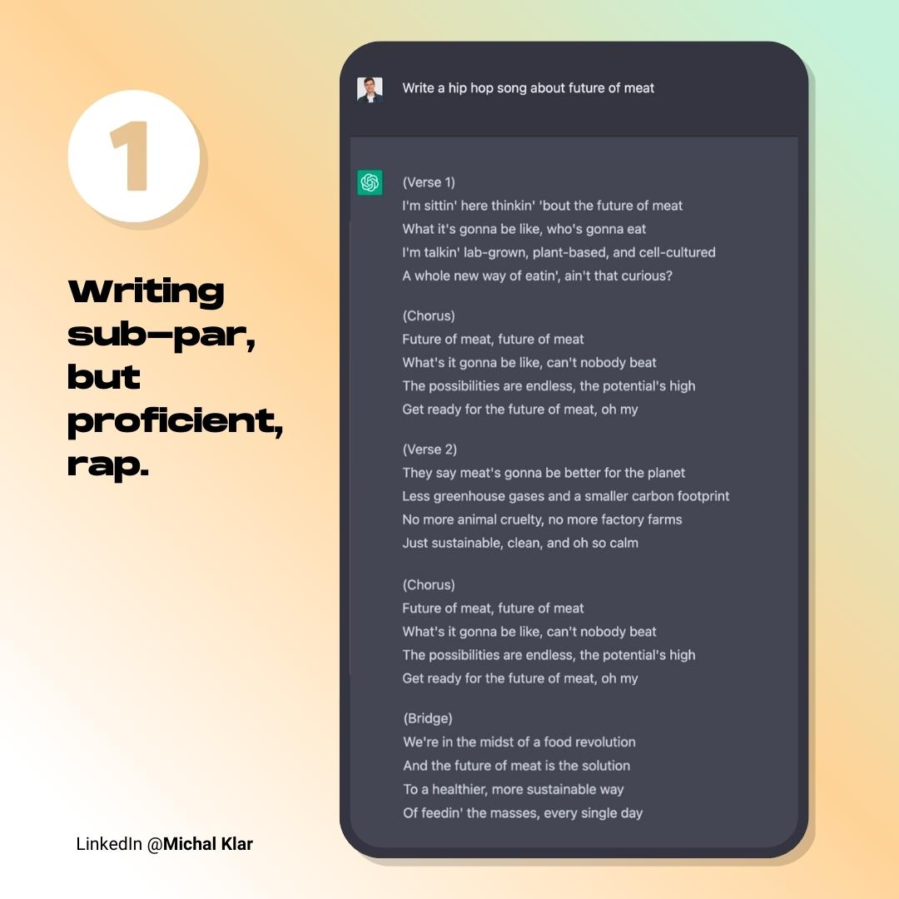
More is here: https://medium.com/illumination/14-creative-ways-to-use-chatgpt-you-probably-didnt-know-about-f0f5d2608c6d

Slide 15
State of the {Art}
https://x.com/Kyrannio/status/1766279366332531182?s=20
https://x.com/LittleTinRobot/status/1767876168945152421?s=20
https://x.com/slow_developer/status/1767885787570332127?s=20
https://x.com/Mr_AllenT/status/1758478643255242755?s=20
https://x.com/Diesol/status/1767258303753818427?s=20
https://x.com/runwayml/status/1768261326751572114?s=20

Slide 16

The Future of AI in Education
The continued integration of AI presents a transformative vision for educational outcomes, enhancing learning experiences and personalized growth.
Ethical considerations, privacy, and the necessity of human oversight are pivotal challenges and opportunities in AI education.
An inspiring call to action is essential for educators to embrace AI's potential for revolutionizing the future of education.

